Slide 1
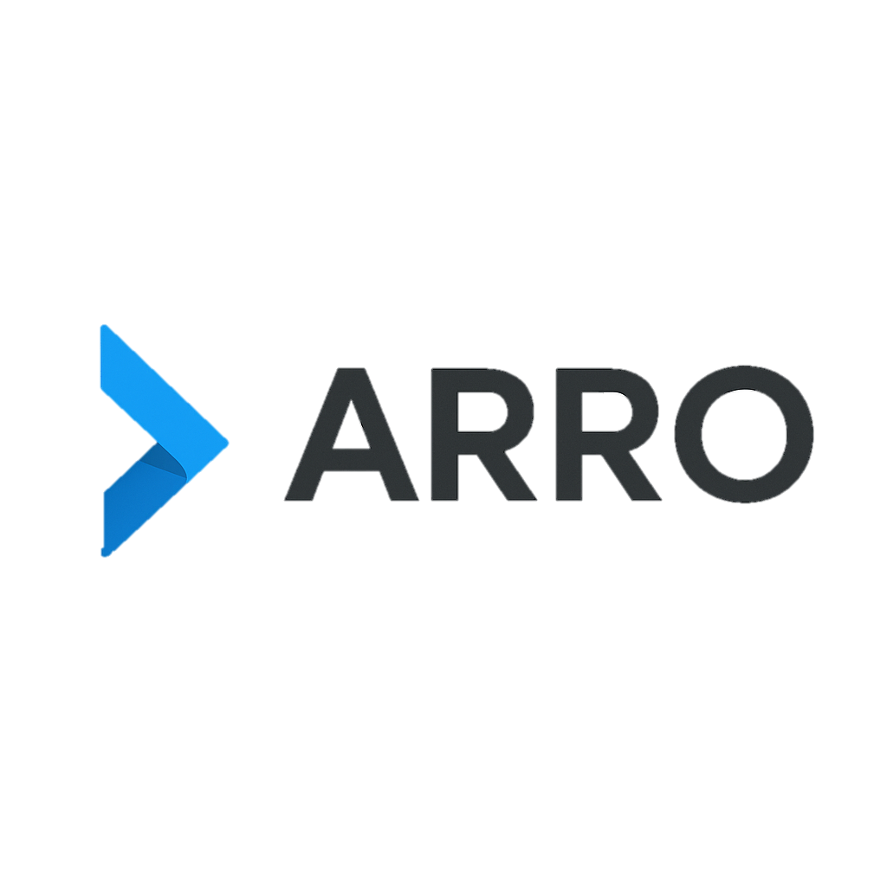
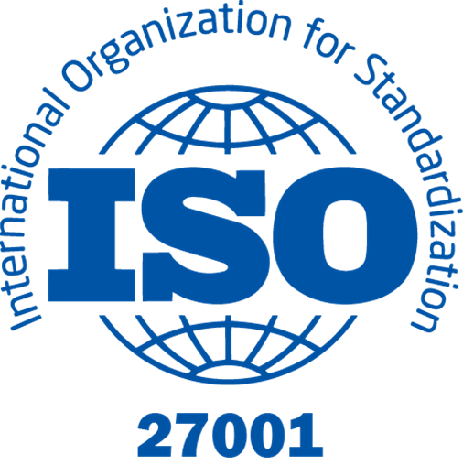
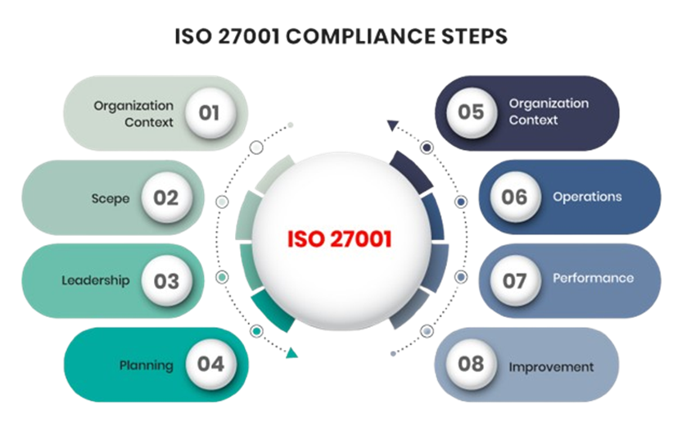
Implementing ISO/IEC 27001:2022 - Implementation Simulation For ARRO (PVT)LTD
SRI LANKA INSTITUTE OF INFOTMATION TECHNOLOGY
IE 3102 – ENTERPRISE STANDARDS FOR INFORMATION SECURITY
Executive Summary
Why ISO 27001: Threats + compliance demands (PDPA, PCI DSS)
Scope: E-commerce, Payments, Logistics, Corporate Ops, AWS Cloud
Gap Analysis: Strong technical but major governance and process.
Risk Assessment: Six critical risks (DB breaches, fraud, fake vendors, ransomware, insider misuse, cloud downtime) rated High / Medium-High.
Roadmap: Phased planning establish ISMS governance, enforce controls, train staff, run BCP/DR tests, prepare for certification.
Strategic Value: Protects sensitive data, ensures compliance, reduces financial/operational risk, and strengthens trust with 1.2M customers & 15K vendors.

Slide 2
Executive Summary
Implementing ISO/IEC 27001:2022 - Implementation Simulation For ARRO (PVT)LTD
SRI LANKA INSTITUTE OF INFOTMATION TECHNOLOGY
IE 3102 – ENTERPRISE STANDARDS FOR INFORMATION SECURITY
Why ISO 27001: Threats + compliance demands (PDPA, PCI DSS)
Scope: E-commerce, Payments, Logistics, Corporate Ops, AWS Cloud
Gap Analysis: Strong technical but major governance and process.
Risk Assessment: Six critical risks (DB breaches, fraud, fake vendors, ransomware, insider misuse, cloud downtime) rated High / Medium-High.
Roadmap: Phased planning establish ISMS governance, enforce controls, train staff, run BCP/DR tests, prepare for certification.
Strategic Value: Protects sensitive data, ensures compliance, reduces financial/operational risk, and strengthens trust with 1.2M customers & 15K vendors.
Current Security Posture
Strengths: AWS redundancy, MFA for admins, fraud detection
Weaknesses: No IS Policy, risk register, IR/BCP, supplier security
Overall posture: technically strong (cloud infra, basic controls), managerially weak (governance, policies, oversight).

Slide 3
Current Security Posture
Executive Summary
Why ISO 27001: Threats + compliance demands (PDPA, PCI DSS)
Scope: E-commerce, Payments, Logistics, Corporate Ops, AWS Cloud
Gap Analysis: Strong technical but major governance and process.
Risk Assessment: Six critical risks (DB breaches, fraud, fake vendors, ransomware, insider misuse, cloud downtime) rated High / Medium-High.
Roadmap: Phased planning establish ISMS governance, enforce controls, train staff, run BCP/DR tests, prepare for certification.
Strategic Value: Protects sensitive data, ensures compliance, reduces financial/operational risk, and strengthens trust with 1.2M customers & 15K vendors.
Strengths: AWS redundancy, MFA for admins, fraud detection
Weaknesses: No IS Policy, risk register, IR/BCP, supplier security
Overall posture: technically strong (cloud infra, basic controls), managerially weak (governance, policies, oversight).
ISO 27001 Gap Analysis Findings
Clause Gaps (Clauses 4–10)
Annex A Control Gaps
(Clause 4) Context – PC
(Clause 5) Leadership – NC
(Clause 6) Planning – NC
(Clause 7) Support – NC
(Clause 8) Operation – NC
(Clause 9) Performance Evaluation – NC
(Clause 10) Improvement – NC
(A.5) Organizational Controls : Missing IS Policy & supplier SLAs.
(A.6) People Controls : No structured training & weak JML process.
(A.7) Physical Controls : Inconsistent access & no secure disposal.
(A.8) Technological Controls : MFA only for admins, weak logging/DR.

Slide 4
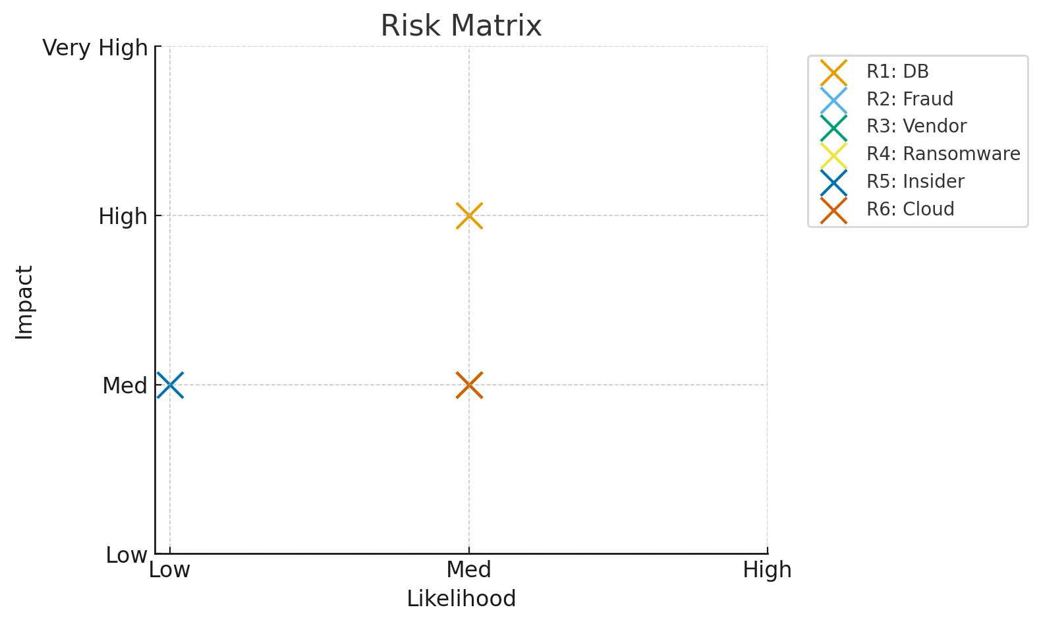
ISO 27001 Gap Analysis Findings
Current Security Posture
Strengths: AWS redundancy, MFA for admins, fraud detection
Weaknesses: No IS Policy, risk register, IR/BCP, supplier security
Overall posture: technically strong (cloud infra, basic controls), managerially weak (governance, policies, oversight).
Clause Gaps (Clauses 4–10)
Annex A Control Gaps
(Clause 4) Context – PC
(Clause 5) Leadership – NC
(Clause 6) Planning – NC
(Clause 7) Support – NC
(Clause 8) Operation – NC
(Clause 9) Performance Evaluation – NC
(Clause 10) Improvement – NC
(A.5) Organizational Controls : Missing IS Policy & supplier SLAs.
(A.6) People Controls : No structured training & weak JML process.
(A.7) Physical Controls : Inconsistent access & no secure disposal.
(A.8) Technological Controls : MFA only for admins, weak logging/DR.
Key Risks & Register Snapshot
Risk ID | Asset | Threat | Risk Level | Treatment
R1 | Customer DB | Unauthorized | High | RBAC, MFA, encryption
R2 | Payments | Fraud | High | SoD, anomaly detection
R3 | Vendor Portal | Fake sellers | High | KYC, SLAs
R4 | Logistics | Ransomware | High | Patch SLAs, DR, EDR
R5 | Employee Data | Insider misuse | Med-High | JML, DLP
R6 | Cloud Infra | DoS/misconfig | High | AWS Shield, redundancy
R1: Customer DB – Weak access control
R2: Payment Systems – Weak monitoring
R3: Vendor Portal – Weak KYC
R4: Logistics – Ransomware risk
R5: Employee Data – Insider misuse
R6: AWS Cloud – DoS/misconfigurations
ARRO (PVT) LTD

Slide 5
Key Risks & Register Snapshot
ISO 27001 Gap Analysis Findings
Clause Gaps (Clauses 4–10)
Annex A Control Gaps
(Clause 4) Context – PC
(Clause 5) Leadership – NC
(Clause 6) Planning – NC
(Clause 7) Support – NC
(Clause 8) Operation – NC
(Clause 9) Performance Evaluation – NC
(Clause 10) Improvement – NC
(A.5) Organizational Controls : Missing IS Policy & supplier SLAs.
(A.6) People Controls : No structured training & weak JML process.
(A.7) Physical Controls : Inconsistent access & no secure disposal.
(A.8) Technological Controls : MFA only for admins, weak logging/DR.
Risk ID | Asset | Threat | Risk Level | Treatment
R1 | Customer DB | Unauthorized | High | RBAC, MFA, encryption
R2 | Payments | Fraud | High | SoD, anomaly detection
R3 | Vendor Portal | Fake sellers | High | KYC, SLAs
R4 | Logistics | Ransomware | High | Patch SLAs, DR, EDR
R5 | Employee Data | Insider misuse | Med-High | JML, DLP
R6 | Cloud Infra | DoS/misconfig | High | AWS Shield, redundancy
R1: Customer DB – Weak access control
R2: Payment Systems – Weak monitoring
R3: Vendor Portal – Weak KYC
R4: Logistics – Ransomware risk
R5: Employee Data – Insider misuse
R6: AWS Cloud – DoS/misconfigurations
Mitigation Strategy (PDCA)
Plan
Check
Act
Do
Plan: Approve IS Policy, governance, supplier contracts
Do: RBAC, MFA, VLANs, SIEM
Check: Internal audits, KPIs, management reviews
Act: DR testing, CAPA, continual improvement
ARRO (PVT) LTD

Slide 6
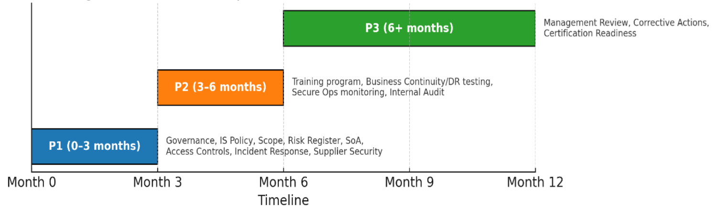
Mitigation Strategy (PDCA)
Key Risks & Register Snapshot
Risk ID | Asset | Threat | Risk Level | Treatment
R1 | Customer DB | Unauthorized | High | RBAC, MFA, encryption
R2 | Payments | Fraud | High | SoD, anomaly detection
R3 | Vendor Portal | Fake sellers | High | KYC, SLAs
R4 | Logistics | Ransomware | High | Patch SLAs, DR, EDR
R5 | Employee Data | Insider misuse | Med-High | JML, DLP
R6 | Cloud Infra | DoS/misconfig | High | AWS Shield, redundancy
R1: Customer DB – Weak access control
R2: Payment Systems – Weak monitoring
R3: Vendor Portal – Weak KYC
R4: Logistics – Ransomware risk
R5: Employee Data – Insider misuse
R6: AWS Cloud – DoS/misconfigurations
ARRO (PVT) LTD
Plan
Check
Act
Do
Plan: Approve IS Policy, governance, supplier contracts
Do: RBAC, MFA, VLANs, SIEM
Check: Internal audits, KPIs, management reviews
Act: DR testing, CAPA, continual improvement
ISMS Roadmap (Phased)
Phase 1 (0–3 months): ISMS governance, MFA/RBAC, supplier checks, SoA document | Phase 2 (3–6 months): Training, BCP/DR testing, Internal Audit | Phase 3 (6–12 months): Management Review, Certification readiness
ARRO (PVT) LTD

Slide 7
ISMS Roadmap (Phased)
Mitigation Strategy (PDCA)
Plan
Check
Act
Do
Plan: Approve IS Policy, governance, supplier contracts
Do: RBAC, MFA, VLANs, SIEM
Check: Internal audits, KPIs, management reviews
Act: DR testing, CAPA, continual improvement
ARRO (PVT) LTD
Phase 1 (0–3 months): ISMS governance, MFA/RBAC, supplier checks, SoA document | Phase 2 (3–6 months): Training, BCP/DR testing, Internal Audit | Phase 3 (6–12 months): Management Review, Certification readiness
KPIs for Success
Governance: 100% roles assigned, ≥95% policy sign-off
Risk Managment: 100% assets risk-assessed
Access Control: MFA ≥95%, RBAC ≥90%
Ops: Patch SLA ≥95%, SIEM ≥90%
Incidents: MTTD ≤24h, MTTR ≤48h
Training: ≥95% completion, phishing fails <10%
ARRO (PVT) LTD

Slide 8

KPIs for Success
ISMS Roadmap (Phased)
Phase 1 (0–3 months): ISMS governance, MFA/RBAC, supplier checks, SoA document | Phase 2 (3–6 months): Training, BCP/DR testing, Internal Audit | Phase 3 (6–12 months): Management Review, Certification readiness
ARRO (PVT) LTD
Governance: 100% roles assigned, ≥95% policy sign-off
Risk Managment: 100% assets risk-assessed
Access Control: MFA ≥95%, RBAC ≥90%
Ops: Patch SLA ≥95%, SIEM ≥90%
Incidents: MTTD ≤24h, MTTR ≤48h
Training: ≥95% completion, phishing fails <10%
Business Value of Certification
Compliance with PDPA & PCI DSS
Builds trust with 1.2M customers & 15k vendors
Reduces downtime, fraud losses, insider threats
Provides competitive advantage in digital marketplace
ARRO (PVT) LTD

Slide 9

Business Value of Certification
KPIs for Success
Governance: 100% roles assigned, ≥95% policy sign-off
Risk Managment: 100% assets risk-assessed
Access Control: MFA ≥95%, RBAC ≥90%
Ops: Patch SLA ≥95%, SIEM ≥90%
Incidents: MTTD ≤24h, MTTR ≤48h
Training: ≥95% completion, phishing fails <10%
ARRO (PVT) LTD
Compliance with PDPA & PCI DSS
Builds trust with 1.2M customers & 15k vendors
Reduces downtime, fraud losses, insider threats
Provides competitive advantage in digital marketplace
Board Actions Required
Approve the Information Security Policy & ISMS governance structure
Allocate budget for:
SIEM & monitoring tools
Training & awareness program
Audit & certification costs
Endorse roadmap to ISO 27001 certification within 12 months
Monitor progress via quarterly KPI & risk reports
ARRO (PVT) LTD

Slide 10
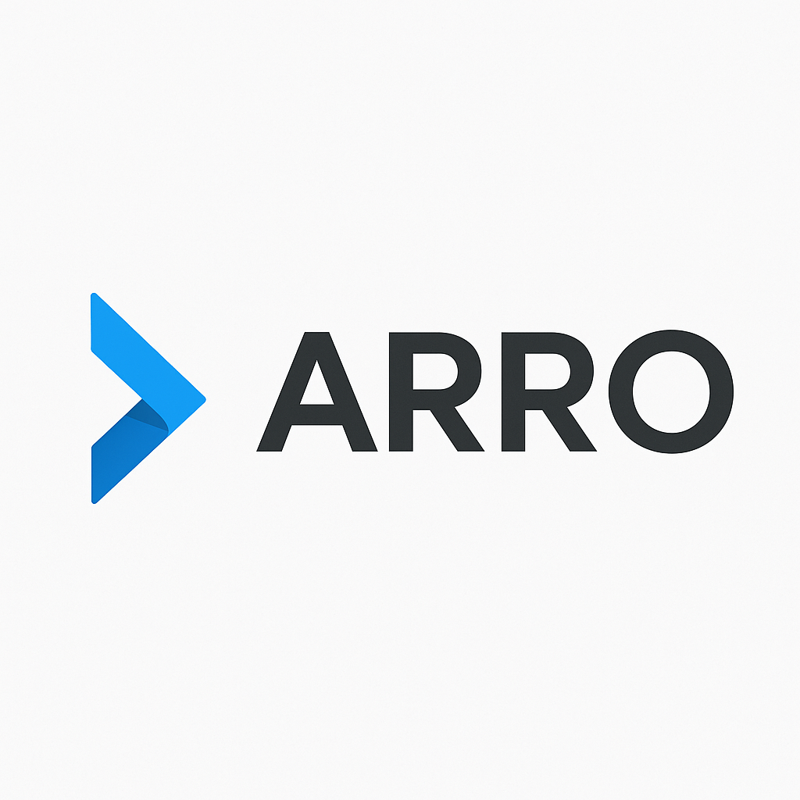
Board Actions Required
Business Value of Certification
Compliance with PDPA & PCI DSS
Builds trust with 1.2M customers & 15k vendors
Reduces downtime, fraud losses, insider threats
Provides competitive advantage in digital marketplace
ARRO (PVT) LTD
Approve the Information Security Policy & ISMS governance structure
Allocate budget for:
SIEM & monitoring tools
Training & awareness program
Audit & certification costs
Endorse roadmap to ISO 27001 certification within 12 months
Monitor progress via quarterly KPI & risk reports
Conclusion
Implementing ISO 27001 is not just compliance
ARRO (Pvt) Ltd has strong technical foundations but major governance gaps.
Weaknesses include missing policies, risk management, supplier security, and incident response.
The phased roadmap provides a clear path to ISO/IEC 27001:2022 compliance.
It is protecting ARRO’s future in Sri Lanka’s digital economy
Strategic benefits: stronger trust, regulatory compliance, operational resilience, and competitive advantage..
ARRO (PVT) LTD

Slide 11
Conclusion
Board Actions Required
Approve the Information Security Policy & ISMS governance structure
Allocate budget for:
SIEM & monitoring tools
Training & awareness program
Audit & certification costs
Endorse roadmap to ISO 27001 certification within 12 months
Monitor progress via quarterly KPI & risk reports
ARRO (PVT) LTD
Implementing ISO 27001 is not just compliance
ARRO (Pvt) Ltd has strong technical foundations but major governance gaps.
Weaknesses include missing policies, risk management, supplier security, and incident response.
The phased roadmap provides a clear path to ISO/IEC 27001:2022 compliance.
It is protecting ARRO’s future in Sri Lanka’s digital economy
Strategic benefits: stronger trust, regulatory compliance, operational resilience, and competitive advantage..
Q&A
Thank You
ARRO (PVT) LTD

Slide 12
Q&A
Conclusion
Implementing ISO 27001 is not just compliance
ARRO (Pvt) Ltd has strong technical foundations but major governance gaps.
Weaknesses include missing policies, risk management, supplier security, and incident response.
The phased roadmap provides a clear path to ISO/IEC 27001:2022 compliance.
It is protecting ARRO’s future in Sri Lanka’s digital economy
Strategic benefits: stronger trust, regulatory compliance, operational resilience, and competitive advantage..
ARRO (PVT) LTD
Thank You

